Slide 1
Parent Maths Session
February 2019
Owls Class

Slide 2
The Curriculum
Number and place value
Addition and subtraction
Multiplication and division
Fractions (including decimals and percentages)
Measurement
Properties of shape
Position and direction
Statistics
Ratio and proportion
Algebra

Slide 3
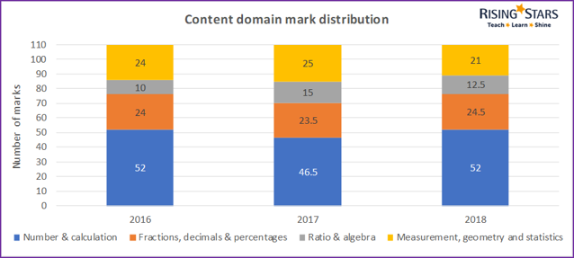
Content Distributions

Slide 4
Written methods of calculation

Slide 5
Written methods of calculation
https://www.youtube.com/watch?v=LScWhYufB2k
Written method of subtraction
https://www.youtube.com/watch?v=A-M9VWZehjo
Written method of addition
https://www.theschoolrun.com/what-is-the-bus-stop-method-for-division
Short division
https://www.youtube.com/watch?v=CSd3Ue8QRyg
Long multiplication
https://www.theschoolrun.com/what-is-long-division
Long division

Slide 6
Maths Lessons
We have daily maths lessons in school
Begin with a short recap on the previous day
Introduce the objective and talk task with the children practising with groups
Children do a short focused activity
Usually review of the activity before another talk task
Followed by independent activities
Finally an evaluation
Our aim is to make children fluent, confident mathematicians.

Slide 7
Maths Meetings
These have arithmetic and reasoning questions and last for approximately 15 minutes.

Slide 8
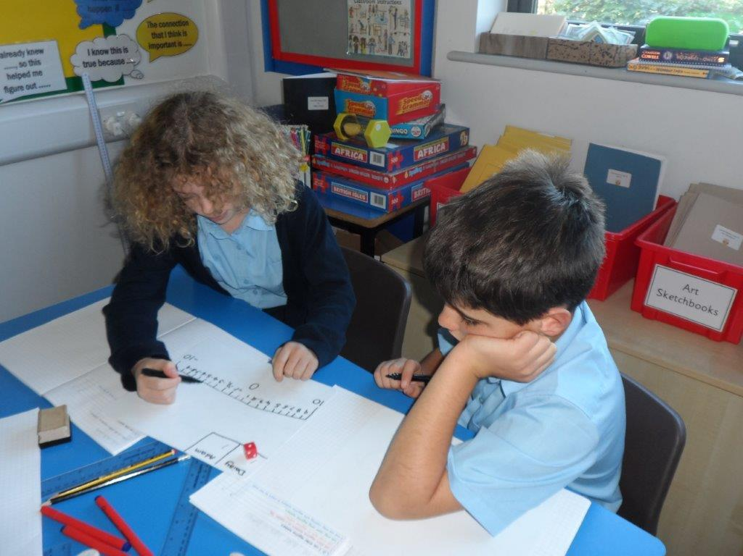
Resources we use in school
Counters
Multilink
Numicon
Number cards
Scales
Measuring cylinders
Clocks
Dice
Place value charts
Fraction tower cubes
Cuisennaire rods
Whiteboards and pens
Each other!

Slide 9
Things you can do at home
The most important thing is build a positive attitude towards maths!
Telling the time ~ calculating time intervals by asking ‘how long until…?’, ‘if this is …… long, what time will it finish?’
Practise reading timetables ~ bus, train, TV guide, etc.
Reading scales ~ weighing when cooking, reading thermometers in the garden, etc.
Changing recipes for different amounts of people, e.g. ‘this recipe is for 12 and we need it for 8’ etc.
Calculating total/ change/ special offers when shopping
Playing games involving adding/ subtracting, e.g. Monopoly
Practise times tables regularly

Slide 10
Helpful resources
Some things that might help!
https://www.bbc.com/bitesize/subjects/z826n39 ~ information and practise for the different curriculum areas
CGP books
https://mathsmadeeasy.co.uk/ks2-revision/ ~ maths questions organised by curriculum content
https://www.timestables.co.uk/ ~ times table practises

